Slide 1
Project Plan
EMEE20002 Project Plan Submission

Slide 2
Project Charter
Project Charter | Date | Date 28/11/2025
Title FPGA Peak Detector | Team ID [insert team here] | Team ID Group 8 |  | Project Manager Xinrui Zhu
Goals | Roles | Roles |  | Responsibilities
Design VHDL programmes to interpret user’s command and detect the peak value and six adjacent ones in a sequence up to 500 samples, then implement it on FPGA by the end of TB2. |  | Xinrui Zhu: Leader of command processor (CP) Yuan Ren CP implementer Julia Yang: CP implementer Xi Zhao Leader of data processor (DP) Yuhao Jiang: DP implementer |  | Xinrui Zhu: CP architecture and ports define Yuan Ren: CP implementation on VHDL Julia Yang: Integrate with FPGA Tx/Rx Xi Zhao: Design DP algorithm Yuhao Jiang: DP implementation on VHDL
In-Scope | Out-of-Scope |  | Stakeholders
Data processor RTL Command processor RTL FPGA synthesis Test and verification | Testbenches Data generator Serial communication of Tx/Rx on FPGA |  | All teammates Dr. Roshan Dr. Karameh Teaching assistants

Slide 3
Work Breakdown Structure
DP: Data Processor
FPGA peak Detector
Algorithm level
Register level
Assemble
Synthesis
Submission
DP pseudocode
CP FSM
Port define
Logic design
Interconnection
CP VHDL
Design & Simulate
DP VHDL
Write code
Packaged VHDL
Link generator
FPGA Bitstream
Link Rx & Tx
Timing constraint
Report
FPGA Product
Video
Design testbench
Simulate
Test & verify
CP: Command Processor

Slide 4
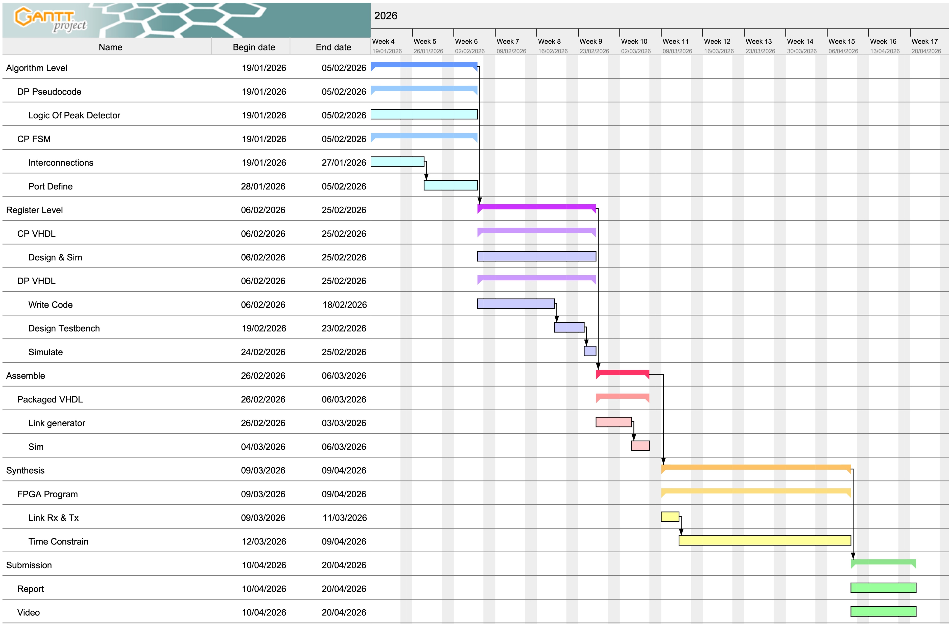
Project Timeline

Slide 5
Risk Register
Date | Raised By | Description | Likelihood | Severity | Risk | Mitigation | Owner
28/11/2025 | Xi Zhao | Member doesn’t complete his own work before a certain deadline. | 2 | 2 | 4 | Arrange weekly meeting to check individual’s progress. | Xi Zhao
28/11/2025 | Xinrui Zhu, Yuan Ren | Simulation result doesn’t meet expectation. (e.g. can’t detect peak) | 4 | 4 | 16 | Draft the code after the algorithm is finished, pay attention to syntax errors. | Xinrui Zhu
28/11/2025 | Xinrui Zhu | FPGA timing doesn’t converge | 4 | 5 | 20 | Get familiar with FPGA workflow from lectures. | Xinrui Zhu
28/11/2025 | Yuan Ren | Team member becomes unavailable (e.g. accidentally injured) | 1 | 5 | 5 | Optimise work distribution and prepare for online collaboration. | Yuan Ren
29/11/2025 | Yuhao Jiang | FPGA board is malfunctioned or damaged | 1 | 5 | 5 | Test the functions at first time, contact university staff for replacement early. | Yuhao Jiang
01/12/2025 | Julia Yang | Inconsistent coding styles of developers leads to inconsistent module interfaces | 3 | 1 | 3 | Write ReadMe document to define essential specs, add comments next to critical code sections. | Julia Yang

